Slide 1

One physician completes suicide every day.
Notes:
https://www.youtube.com/watch?v=vQ7vJlh5xKY

Slide 2
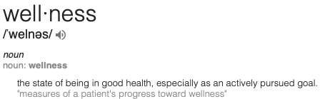
Wellness ?
Notes:
1) Confused stares and silence. It often looks like the face a dog makes when it does not know what it is looking at … the head tilt and furrowed brow of complete confusion.
2) A 45 minute debate about the meaning of the word. Is wellness more than just the absence of disease? Can you have an adequately treated disease and be well? If everyone’s definition of wellness is different, how can we create physician wellness in a group of 120 doctors?
3) A small number from the old guard muttering “physician wellness … bah … that’s just for pansies and women who never learned how to work like we had to when I was a resident.” (this is a direct quote … not my words)
“Wellness” is a totally foreign concept in healthcare – it is a non-starter
Think about it. We don’t learn about health and wellness in our training. We never even used the word wellness in medical school and residency – not once. We were too busy learning a physician’s basic trade – diagnosing and treating disease. Our “healthcare” system is a disease management system. Doctors’ bandwidth is occupied 110% by rooting out disease and helping our patients prevent and treat it as best we can.

Slide 3
Foreign Concept
The disease is physician burnout
The risk factor is physician stress
The task is to minimize the risk and prevent, detect and treat the disease.

Slide 4
Today’s talk
Definition of Burnout
Why Does it Matter
Why Burnout?
What Can we Do About it

Slide 5
The difference between Stress and Physician Burnout is this: ability to recover in your time off.
Physical and Emotional Exhaustion
Depersonalization
Reduced Sense of Personal Accomplishment
Notes:
Physician Burnout begins when you are NOT able to recharge your batteries between call nights or days in the office. You begin a downward spiral that has three distinct symptoms
1) Physical and Emotional Exhaustion:
You are emotionally drained, depleted and worn out by work and unable to recover in your non-working hours. This is the most common symptom of burnout by far. When burnout prevalence surveys identify the percentage of physicians suffering from "at least one symptom of burnout" - this is the most common burnout symptom.
2) Depersonalization:
The Development of a negative, callous and cynical attitude toward patients and their concerns (“my patients are so #%*&!”). The cardinal sign here is cynicism, sarcasm and feeling put upon by your patients.
3) Reduced Sense of Personal Accomplishment:
The tendency to see your work negatively, as without value or meaningless (“what’s the use?”) and see ourselves as incompetent. Another piece of internal dialog at this stage is, "I'm afraid if so

Slide 6
Burnout
50% of medical students
50% of doctors
25-75% of residents
Notes:
28% of the general population think they are burned out.
78 Percent of Physicians Have Experienced Burnout in their Medical Practices
The Physicians Foundation’s 2018 survey, now in its sixth edition, reveals some startling findings about the impact of several factors driving physicians to reassess their careers.
The survey of nearly 9,000 U.S. physicians across the country examines the impact of poverty on healthcare outcomes, practice patterns, career plans, how physicians are responding to the opioid crisis and perspectives of today’s physicians.

Slide 7
Why does it matter ?

Slide 8
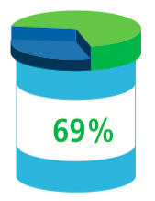
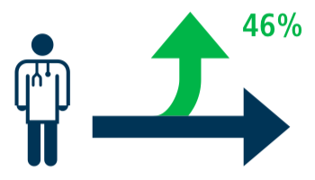
62 %
62% of physicians are pessimistic about the future of medicine
46 % of physicians pan to change career paths
Notes:
62% are pessimistic about the future of medicine.
46% plan to change career paths.
49% would not recommend medicine as a career to their children
Culture matters

Slide 9
Everyone Pays a Price
Physician’s own health and well-being suffers

Slide 10
Emotional and physical exhaustion
25% increase in odds of alcohol abuse/dependence
Motor vehicle crashes
Double risk for suicidal ideation
Physician greater risk of suicide compared to the general population
⬆ 70% in male physicians and
250% higher in female physicians
US physicians have the highest suicide rate of any profession
Notes:
15% SUFFER FROM ALCOHOLISM general population 7%

Slide 11
Everyone Pays a Price
Physician’s own health and well-being suffers
Increased medical errors
Notes:
Increased rates of physician substance abuse, suicide, and intent to leave practice

Slide 12
Burnout doubles risk of medical error.
Notes:
ICU increased mortality

Slide 13
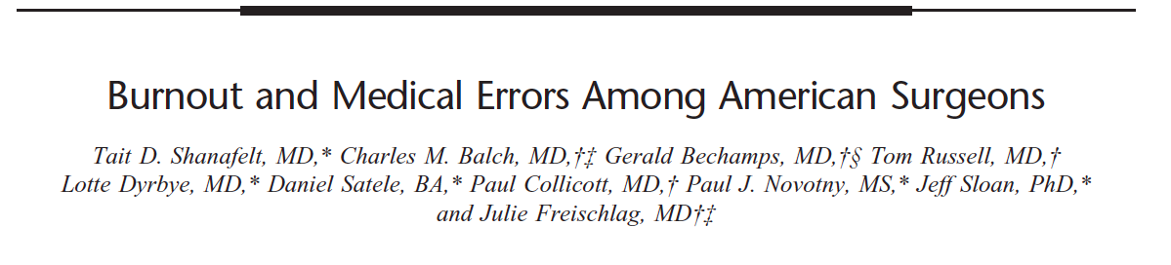
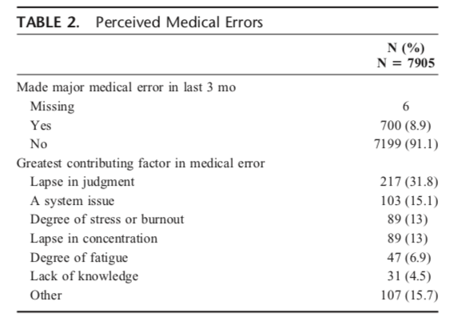
Strong relationship between surgeon distress and perceived medical errors
Burnout and depression were among the strongest factors associated with reporting an error
70% of surgeons thought error was due to individual factors
Notes:
Emotional exhaustion, Depersonalization, Personal accomplishment, mental quality of life (not physical QOL) and career satisfaction all played a statistically significant role
Approximately 9% of participating surgeons reported they had made a major medical error in the past 3 months.
individual factors (lapse in judgment, stress, burnout, lapse in concentration, fatigue)
No relationship between fatigue and error (call night, hours worked)

Slide 14
Strong relationship between surgeon distress and perceived medical errors
Burnout and depression were among the strongest factors associated with reporting an error
70% of surgeons thought error was due to individual factors
bidirectional relationship between medical errors and distress
Notes:
Complications beget complications
feel inadequately supported by their health care organization as they attempt to cope with their mistake.
Surgeons have a tendency to blame themselves for errors that affect their patients even when they are only part of the process leading to error rather then its sole cause

Slide 15
Everyone Pays a Price
Increased rates of physician substance abuse, suicide, and intent to leave practice
Increase in medical errors
Increase in malpractice rates

Slide 16
Burnout results in 17% increased odds of being named in a medical malpractice suit.
Notes:
Because physician burnout can result in poor judgment in patient care decision-making,
hostility toward patients,
adverse patient events,
less compassion, and diminished commitment and dedication to productive, safe, and optimal patient care.
Majority of malpractice claims are without merit, where nearly two-thirds of claims are dropped, withdrawn, or dismissed.
Of the 10% of claims that are decided by a trial verdict, nearly 90% are decided in favor of the physician.45

Slide 17
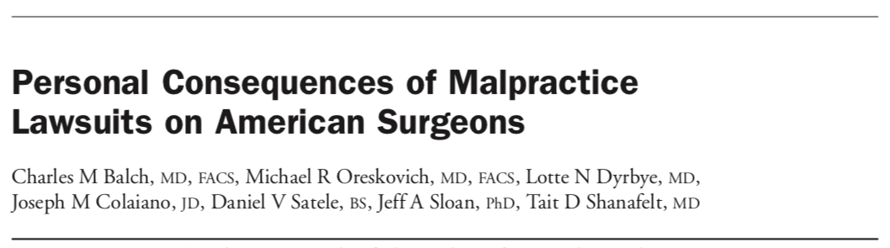
1,764 of 7,164 (24.6%) responding surgeons were involved in a recent malpractice suit.
Recent malpractice suits were strongly related to burnout (P < 0.0001), depression (P < 0.0001), and recent thoughts of suicide (P < 0.0001) among surgeons.
Hours worked, nights on call, subspecialty, and practice setting were also independently associated with recent malpractice suits.
Notes:
By age of 65, 99% in high-risk specialties (neurosurgery, thoracic, cardiovascular, orthopedic and plastic surgery).
Its not the medical mistake – it is the break down of patient physician relationship – and this is more likely when you are burned out
Of the approximately 25,073 surgeons sampled, 7,164 (29%) returned surveys.
were younger, worked longer hours, had more night call, and were more likely to be in private practice (all P <0.0001).
Majority of malpractice claims are without merit, where nearly two- thirds of claims are dropped, withdrawn, or dismissed.
Of the 10% of claims that are decided by a trial verdict, nearly 90% are decided in favor of the physician.45
Its not the medical mistake – it is the break down of patient physician relationship – and this is more likely when you are burned out
The process of claims and litigation can take an average of 5 years to resolve and can have a protracted impact on the physician.48

Slide 18
Everyone Pays a Price
Physician’s own health and well-being suffers
Increase in medical errors
Increase in malpractice rates
Burnout is expensive

Slide 19
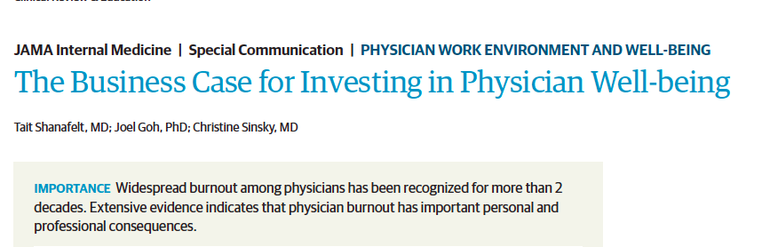
TURNOVER
Recruiting and replacing a physician =
$500,000 - $1,000,000
Indirect cost . . .
Notes:
long-term viability due to the relationship between burnout and lower quality of care, decreased patient satisfaction, and problems with patient safety.
Poor care
Malpractice
Loss in productivity
Increase in health care expenditure more referrals, more testing

Slide 20

Burnt-out physicians who choose not to leave the profession are more likely to reduce their work hours.
Notes:
One point increase in the Maslach burnout inventory 28% more like to reduce hours and 67% more likely to reduce effort
Extrapolated to the national level loss of productivity annually is estimated to equate the loss of the graduating class of 7 medical schools
This does not account for physician loss such as early retirement (17%) and leaving the profession altogether (12%)
This is also on top of a shortage of physicians of 900.000 by 2025. This is 6 ! years from now

Slide 21
Decrease physicians’ professionalism and the quality of medical care they provide
Poor judgment
Hostility toward patients
Less compassion
Diminished commitment to safe patient care
Notes:
Threat to financial and long-term viability due to the relationship between burnout and lower quality of care, decreased patient satisfaction, and problems with patient safety.

Slide 22
Everyone Pays a Price
Physician’s own health and well-being suffers
Increase in medical errors
Increase in malpractice rates
Burnout is expensive
Family

Slide 23
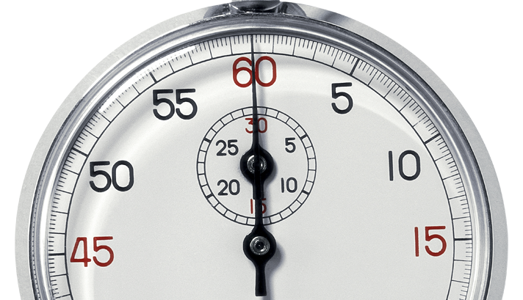
Time for a poll . . .

Slide 24
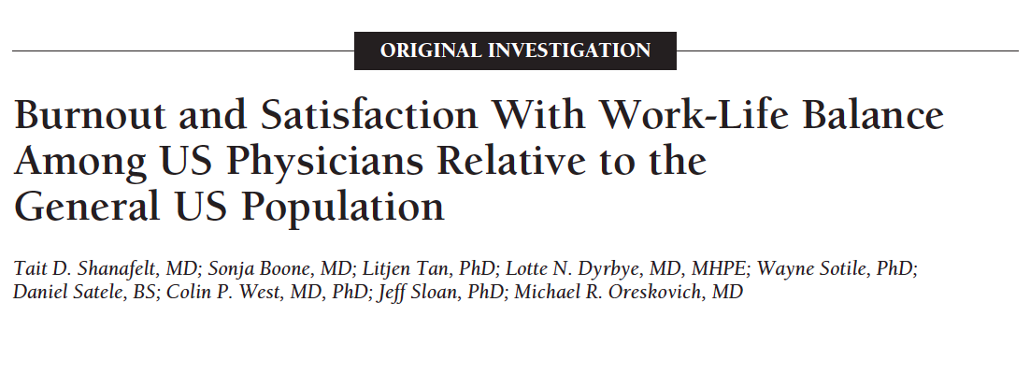
Age, gender, debt, relationship status, age of children, spousal occupation
35-40% of the general population reported that their work has “no impact” on their children; <10% of physicians
Nearly half of physicians reported their career had a negative impact on their relationships with their children
Notes:
54% having a child under the age of 21
Non medical spouse 23%
Survey 6880- MDs, 19% response rate
81% had kids (about 5800)
71% were male
43% has children >21 y/o
<5-22 15% each
54% private practice
This clear stepwise incremental association between level of education and the perception that the ensuing career had a positive impact hold true only among non-physicians.
Physicians do not feel that their doctoral degree in medicine has as positive an impact on their children as non-physicians do
Surgeons 50-60% recommend against it (Annals of Surgery • Volume 251, Number 6, June 2010)
Would you recommend your children pursue a career as a physician/surgeon? 40-50%

Slide 25
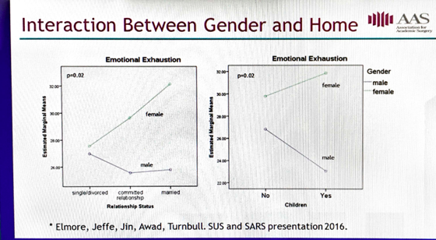
Caprice C. Greenberg, MD, MPH gives her AAS Presidential Address “Sticky Floors and Glass Ceilings” during the 2017 Academic Surgical Congress in Las Vegas, NV.
Notes:
A home life gives solace to male physicians; it does the opposite to women
Although 90% male surgeons have kids, only 45% of female surgeons have children
Suicide rates in women are xx that of male doctors
This a discussion beyond burnout and reaches into the area of gender equality but I think the discussion about gender equality and burnout are one and the same
Most women are not fully supported workers and if they are, they still perform most of the home responsibilities and chores and are primary care giver
Women have to push back the 400-pound gorilla – what being a surgeon can be – to make room for other things, but this might be what surgery culture needs
As of now women get punished for this push back -- the payment gap and lackluster promotion and recognition are real

Slide 26

67% surgical resident burnout rate
− Hostile faculty
− Inadequate OR time
− Social stressors
+ meaningful mentorship
The addition of expanded and more specific requirements regarding resident and faculty well-being emphasize the need for programs and institutions to prioritize well-being and recognize that physicians are at increased risk for burnout and depression.

Slide 27
Why Burnout ?
Notes:
INTINSIC AND EXTRINSIC FACTORS

Slide 28
Era of physician professional autonomy
was replaced by
Era of measurement and accountability
Notes:
1999 publication of the Institute of Medicine’s “To Err is Human” report, highlighting the prevalence of medical errors, brought new attention to quality improvement and the value of physician reporting and accountability.
“society conceded to the medical profession a privilege most other work groups do not get: the authority to judge the quality of its own work.”
unexplained variation in physician practice styles, high rates of medical injury from errors in care, and social and racial disparities prevalent in medicine came to light.

Slide 29
Era of measurement and accountability
Rewards, punishment and pay for performance
Mandatory measures do not really correlate with quality of care provided
Doubling of number of physicians over the past 35 years; 3000% increase in administrators
➔ Lack of control and support

Slide 30
EMR
The 2018 survey of the American physician identified EMR as the single most important “pain point” confronted by physicians in their practice.
“a system that proposed to increase physician's mastery over their work has, instead, increased their work’s mastery over them.“
Atul Gawande
Notes:
2 hours screen time fore every one hour face-to-face time with patients
“meaningful use” of electronic health records (EHRs), which transformed the practice of many physicians, was mandated as part of the 2009 American Reinvestment and Recovery Act.

Slide 31
Time for a poll . . .

Slide 32
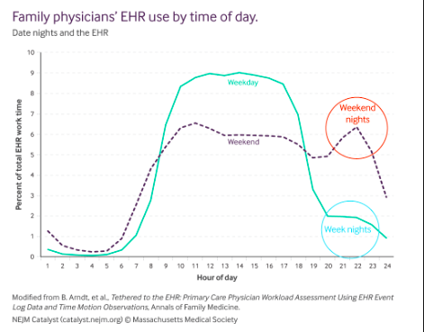
EMR

Slide 33
How many times a week do you receive a real compliment from any member of the healthcare team?
Average: <2 per week

Slide 34
How many times a week do you experience an unpleasant interaction with a hospital co-worker?
High: 45 per week
Low: 10 per week

Slide 35
How often does a patient or family member show anger toward you in week?
Average: 21 per week
Highest Concentration: Clinic

Slide 36
Number of unique interactions per week with someone who is dying or at high risk of dying?
Average: 65 per week
High: 120 per week

Slide 37
n=49

Slide 38
It is daunting to be a surgeon
Relentless decision-making
Hyper-intense communications
Fear of malpractice litigations
Unrealistic and angry patients
Dealing with mayhem, tragedy, and death
Notes:
Caroline Elton
Well, I think many people go into it thinking it’s going to be all glamorous. They are sometimes motivated by what I call the “George Clooney ‘E.R.’ effect,” envisioning a life where they’ll be saving lives, saving the day.
“I didn’t realize there would be so many deaths.”
In these days of a “write-up culture” hospitals make physicians feel as if they inhabit the
lowest rung of hierarchy
Worth of physician has dwindled down to the three letters RVU.
BUT WE DID NOT THINK IT WOULD HARM US – ‘WHO WOULD SIGN UP FOR A JOB THAT PUTS YOUR OWN HEALTH AT RISK

Slide 39
It is daunting to be a surgeon
Relentless decision-making
Hyper-intense communications
Fear of malpractice litigations
Unrealistic and angry patients
Dealing with mayhem, tragedy, and death
Notes:
Well, I think many people go into it thinking it’s going to be all glamorous. They are sometimes motivated by what I call the “George Clooney ‘E.R.’ effect,” envisioning a life where they’ll be saving lives, saving the day. Frequently, the complexity of being a physician and the exposure to suffering is daunting. I’ve had doctors say, “I didn’t realize there would be so many deaths.”
In these days of a “write-up culture” hospitals make physician feel as if they inhabit the lowest rung of hierarchy.
Anyone, including those lacking the medical knowledge and the necessary insight to understand an urgent situation, is able to negatively document against a physician
Worth of physician has dwindled down to the three letters RVU.
Empathy more burnout compassion – being able to do something about it
Noticing and responding to to emotions NURSE

Slide 40
Hyper-intense communications
Are we (well) trained to handle these conversations?
Are we trained to handle emotions?
Data show that up to 70% of emotional cues in surgeon’s office are not responded to
Encouragement to respond to emotions increased burnout !
Education session on how to respond to emotions
Notes:
N - Name it
“...it sounds like you’ve been worried about what’s going on...”
U - Understand the core message:
“...if I understand you correctly, you are worried about what to say to your family and how they will react...”
R - Respect /Reassurance at the right time:
“...I’m really impressed that you’ve continued to be independent ...”.
S - Support:
“... would you like me to talk to your family about this...”
E - Explore:
“... I notice that you’re upset, can you tell me what you’re thinking?”

Slide 41
Moral injury
88% of physicians have reported that some, many, or all of their patients are affected by social determinants.
Conditions such as poverty, unemployment, lack of insurance, and addictions all pose a serious impediment to their health, well-being, and eventual health outcomes.
Notes:
The demoralizing misalignment of the physician values and his or her ability to meet his or her patients’ needs due to conditions beyond the physician’s control
Such as poverty, lack of insurance (approval), short appointment times and patients’ demands and expectations, has been termed MORAL INJURY

Slide 42
That’s not me . . .

Slide 43
Question ?
When you get out of the hospital and experience normal healthy people out there having fun, what feelings and thoughts do you have?

Slide 44
Time for a poll . . .

Slide 45
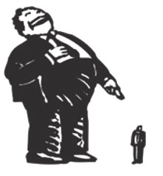
How often do you belittle those of other specialties or other jobs ?
As being dumb
Or lazy
Or worthless
Or self-centered
Or just plain nasty
Ever direct this to the patients?

Slide 46

How are you on the phone?
When someone calls
In the middle of the night
And it is not the most sophisticated or well-thought-out of questions

Slide 47
What can we do ?

Slide 48
Driver
Excessive workload
Individual-level Solutions
Part-time status, Informed specialty & practice choices
Efficiency and skills training
Fair productivity targets
Work inefficiency
& lack of support
Loss of control
& autonomy
Loss of meaning
Organization-level Solutions
Lack of work–home
Integration
Non-physician staff support, EMR
Reflection of life priorities
Resilience training, Mindfulness
Small-group, appreciation inquiry
Flexible work schedules, respect home responsibilities
Physician leadership
Awareness, development opportunities

Slide 49
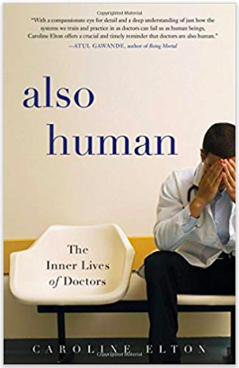
“There are two people in the patient-physician relationship and we cannot forget about the physician in the interaction. “
Caroline Elton
Notes:
Caroline Elton
vocational psychologist Caroline Elton introduces us to some of the distressed physicians who have come to her for help:
patient-centered care
Cleveland Clinic: patient always comes first
2 people in the patient-physician relationship and we cannot forget about the physician in the interaction
If the physician is not well, this relationship cannot not work, even if dictated from above – only leads to more frustration, sense of failure, and burnout
As sensible as self-compassion sounds doctors have a hard time with the idea; it sounds like self-pity or self–indulgence
not getting carried away with one‘s own emotional drama. Rather, it is a movement Toward a health balance.
Instead of mercilessly judging and criticizing yourself for various inadequacies or shortcomings, self-compassion means you are kind and understanding when confronted with personal failings – after all, whoever said you were supposed to be perfect?
Difficult in our culture
Docs always perfect

Slide 50
Winning is not everything; It’s the only thing!
Perpetual Peak Performance
Notes:
After all, whoever said you were supposed to be perfect?
Difficult in our culture
Docs always perfect
Preparation of star athletes for the big day – md every day big day
Mindfulness, visualization goal setting backfire – focus on performance aspect you can control (attitude and effort)
Certain amount of anxiety before an interaction is normal – when is it too much
Don’t neglect the effect poor outcomes have on you
“I may not be as good as I think I am” - defeated confidence leads to diminished risk-taking, diminished effort, diminished perseverance

Slide 51

Share positive stories to catalyze and spread culture change
Appreciative inquiry
Focusing on the positives can help individuals recognize what gives life, vitality, and joy to practice.
Notes:
Cleveland Clinic half day all employees $11 million have to invest to get back to become the best.
Lose sight of what you really like about being a doctor
MONEY WELL SPENT
Focusing only on what's wrong in an organization, such as a clinical practice or department, can lead to exclusive attention to problems and create a negative atmosphere, whereas taking the time to focus on the positives can help individuals recognize what gives life, vitality and joy to the practice.
Fostering the best in one another begins with noticing what is being done well. For example, providing recognition for a job well done has been shown to significantly lower physician burnout scores and result in other positive organizational results.²
Introduce appreciative inquiry on a small scale by including appreciative check-in or debrief in your staff meetings. Using these tools in meetings will familiarize your team with the concept of appreciative inquiry through experiential learning.
To use appreciative check-in, before beginning your meeting's stated agenda, pose a positively focused question to the team and allow each team member to respond. Possible questions include:
“What is something that went well for you today?”
“What is a recent positive experience in your work or personal life?”

Slide 52

Resiliency
Physicians who practice resiliency are better equipped to handle the many challenges presented in medical training and when providing patient care.
Write your individual mission statement.
What do you stand for?
What matters to you?
Write it down.
Notes:
= stay positive during adversity
But in high-stress profession the pressures are ongoing
Real resilience is being prepared to be unprepared
Anti-fragile
Resiliency is the ability to adapt to and bounce back from the stress of the training and/or clinical environment. Physicians who practice resiliency are better equipped to handle the many challenges presented in medical training and when providing patient care and, therefore, are less likely to experience burnout.
These steps range from the basics, such as ensuring adequate nutrition, sleep and exercise, to more deliberate reflective approaches, which include narrative practices, mindfulness practice, reconnection with purpose and meaning and peer group interaction.
Write your individual mission statement yardstick (This is my final recommendation:) Think about the metric by which you want your life to be judged, and make a resolution to live every day so that in the end your life will be judged a success.
What do you stand for? Write it down. Each time you are considering doing something, ask yourself whether this action is consistent with your mission statement. This may help you decide whether to agree to do it or not. Many CEOs write their own personal mission statements to guide their decisions.
Identify and prioritize your values and compare them to how you spend your time.
Write down inspiring patient stories
Regardless of whether you use a formal or personal approach, writing patient stories as narratives rather than for the medical record is a powerful way to connect with inevitable emotions stirred up by some patient contact.
PEER support Healthcare providers are frequently exposed to extremely unsettling events (such as the death of a child) and may be involved in adverse outcomes. To help providers cope with these situations, Dr. Jo Shapiro of Brigham and Women's Hospital in Boston initiated a peer support program for her colleagues.

Slide 53
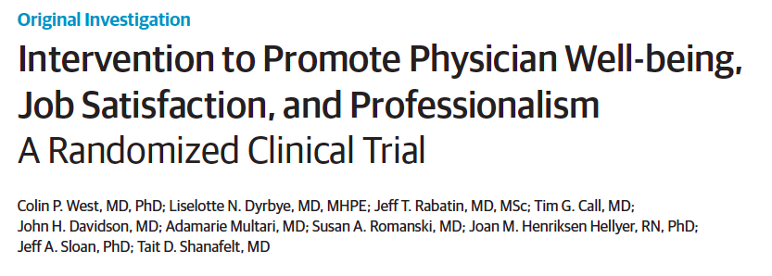
Randomized clinical trial of 74 practicing physicians in the Department of Medicine at the Mayo Clinic in Rochester
Intervention: discussion groups incorporating elements of mindfulness, reflection, shared experience
Empowerment and engagement at work ⬆
Stress, symptoms of depression, quality of life, or job satisfaction ➔
Rates of depersonalization, emotional exhaustion & overall burnout ⬇
Notes:
Randomized clinical trial of 74 practicing physicians in the Department of Medicine at the Mayo Clinic in Rochester
Empowerment and engagement at work increased
Statistically significant differences in stress, symptoms of depression, overall quality of life, or job satisfaction
Rates of depersonalization, emotional exhaustion, and overall burnout decreased substantially in the trial intervention arm
An intervention for physicians based on a facilitated small-group curriculum improved meaning and engagement in work and reduced depersonalization, with sustained results at 12 months after the study.
Interventions The intervention involved 19 biweekly facilitated physician discussion groups incorporating elements of mindfulness, reflection, shared experience, and small-group learning for 9 months. Protected time (1 hour of paid time every other week) for participants was provided by the institution.
Those in the control arm could schedule and use this hour of protected time
in any manner they believed was most useful but did not participate
in the formal curriculum.

Slide 54
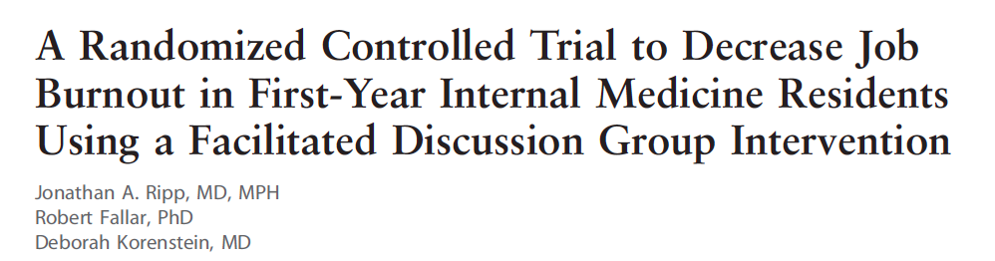
Group discussion intervention did not decrease burnout in resident physicians.
More residents in the intervention group had high year-end depersonalization scores (P =0.04).
Another obligation on top of clinical or educational responsibilities.

Slide 55
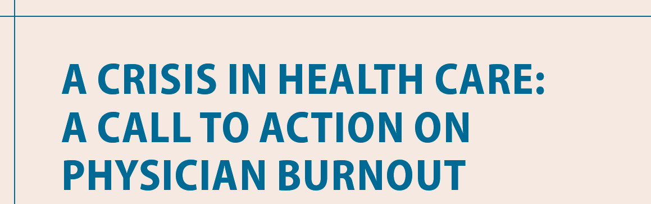
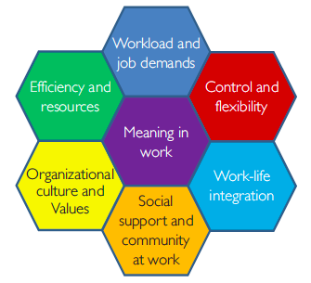
Restriction of resident work hours
Reduction in work hours
Peer support
Chief wellness officer
Burnout quality indicator for health care system
Notes:
Makeshift solutions fail to address root causes
“self-care” strategies (fruit bowl and tea kettle in the call room)
Experience and consequence of the burnout are the responsibility of the individual physicians
Akin to asking drivers to avoid car accidents without investing in traffic safety and improving hazardous roads
Asking physicians to work harder to mange their own burnout will not work
Improve the work life of health care providers
Staffing, workflow OMR, workplace culture, peer support
Stanford and Kaiser Permanente
bmc

Slide 56
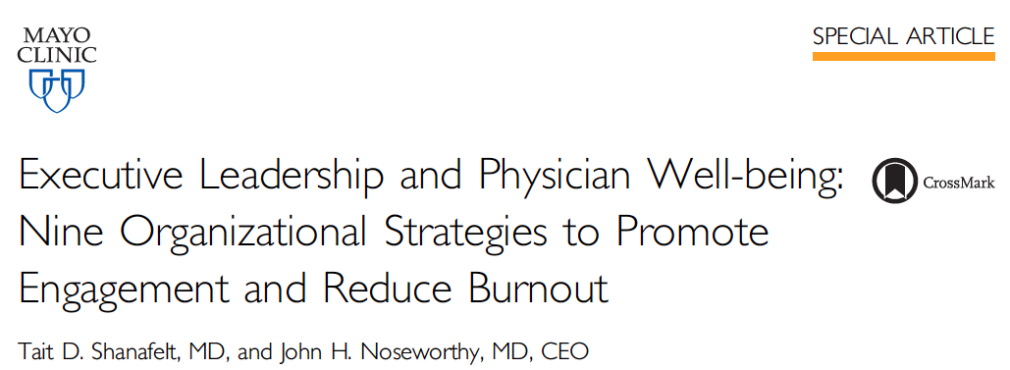
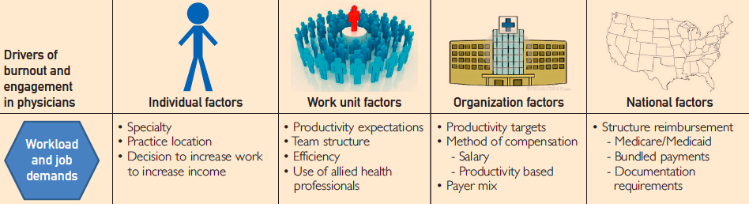

Slide 57

Brain Storm Session – call to action

